Slide 1
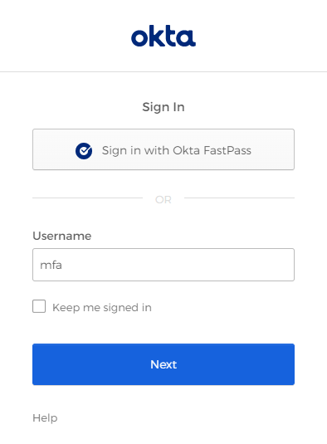
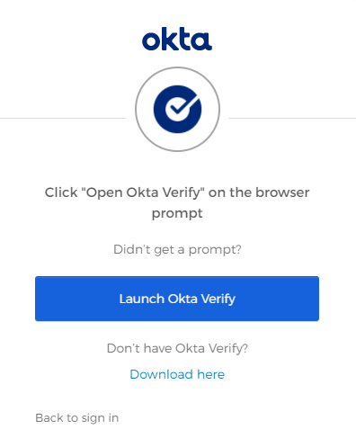
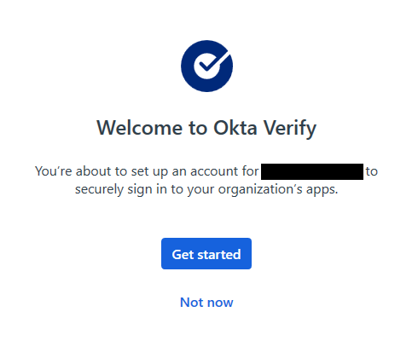
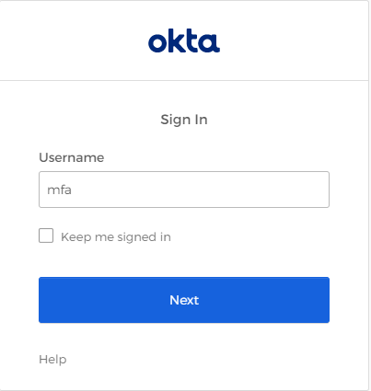
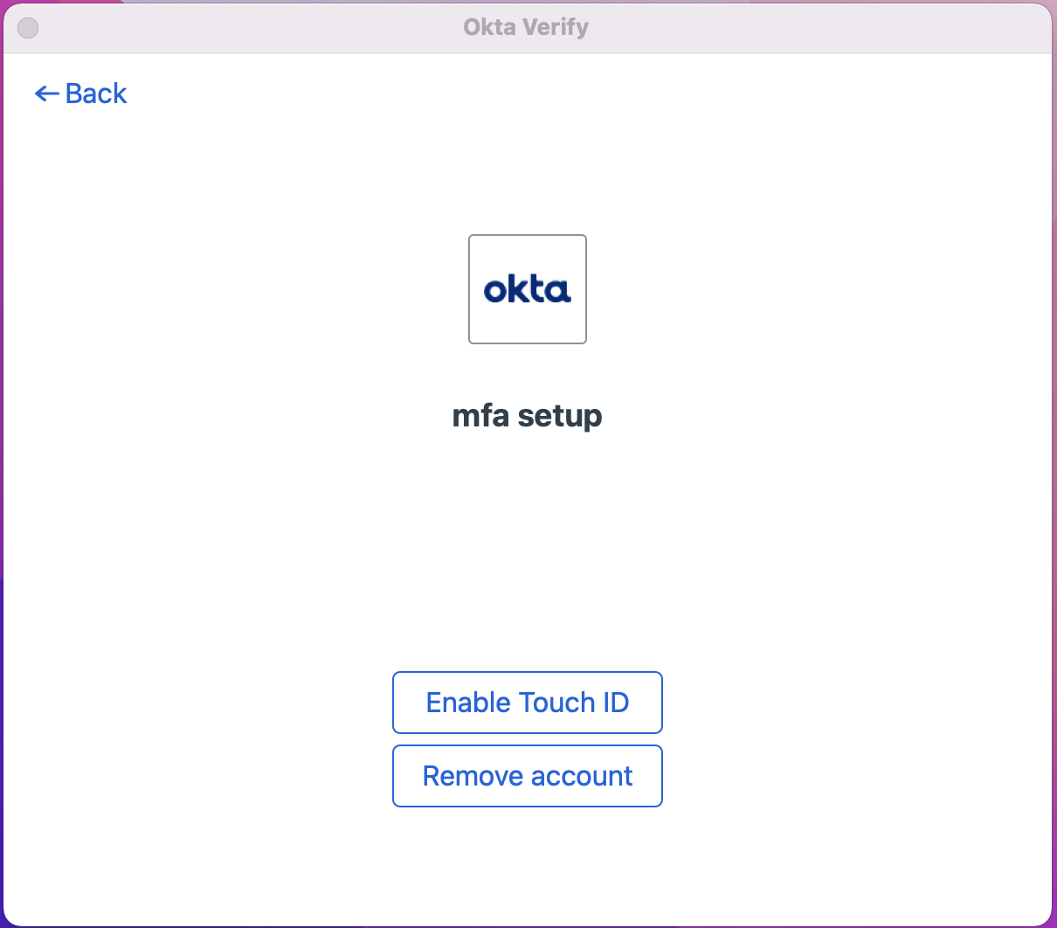
Enrolling in Okta Verify for macOS
This guide details how to install and enroll Okta Verify for macOS (v 10.15 or later). Please contact <help desk> if you experience any issues.
1
Navigate to your Okta org
2
Launch or Install Okta Verify
3
Enroll Okta Verify
In your preferred browser, enter <Okta Org URL> and click Sign in with Okta Fastpass
Click Launch Okta Verify if already installed on your system. Otherwise, click Download here to install.
Click Get Started, then Next
Click Launch Okta Verify after installation has completed.
4
Enroll Okta Verify
5
Enable Windows Hello
6
Enrollment Complete
A new browser tab will open. Log into your Okta org with your username and password
Click Enable TouchID to allow Okta Verify to use your Mac’s TouchID capabilities
You can now use the Sign in with Okta FastPass option to log into Okta using Okta Verify for Windows

